Slide 1

Self-care and Resilience in Challenging Times
Part Three:
Creating Your Self-Care Plan Now!
Jeffrey E. Barnett, Psy.D., ABPP
LCAS Dean’s Office
January 5, 2021

Slide 2

Your Self-Care Plan:
First Steps
Make a list of stressors in your life (professional and personal). Write them down and update as needed.
In addition to all the typical challenges and stressors in your work and life, be sure to include how the pandemic has added to them.
Write a list of self-care activities relevant and accessible to you. Remember they need to be enjoyable, relaxing, or rejuvenating.
Write out the maladaptive coping strategies you are at risk of using.
List your personal warning signs of the need for increased self-care or changes in your life.

Slide 3
First Steps (Cont.)
Do regular self-assessments/check-ins to monitor for their presence.
Write out a tentative self-care plan.
Make time for self-care and intentionally integrate it into your schedule and routines.
Be sure to have realistic goals and expectations of yourself.
Focus on the habit or routine and its positive effects, not on how much or how well you are doing it.
Remember that there is no finish line to be crossed. This is about lifestyle.

Slide 4
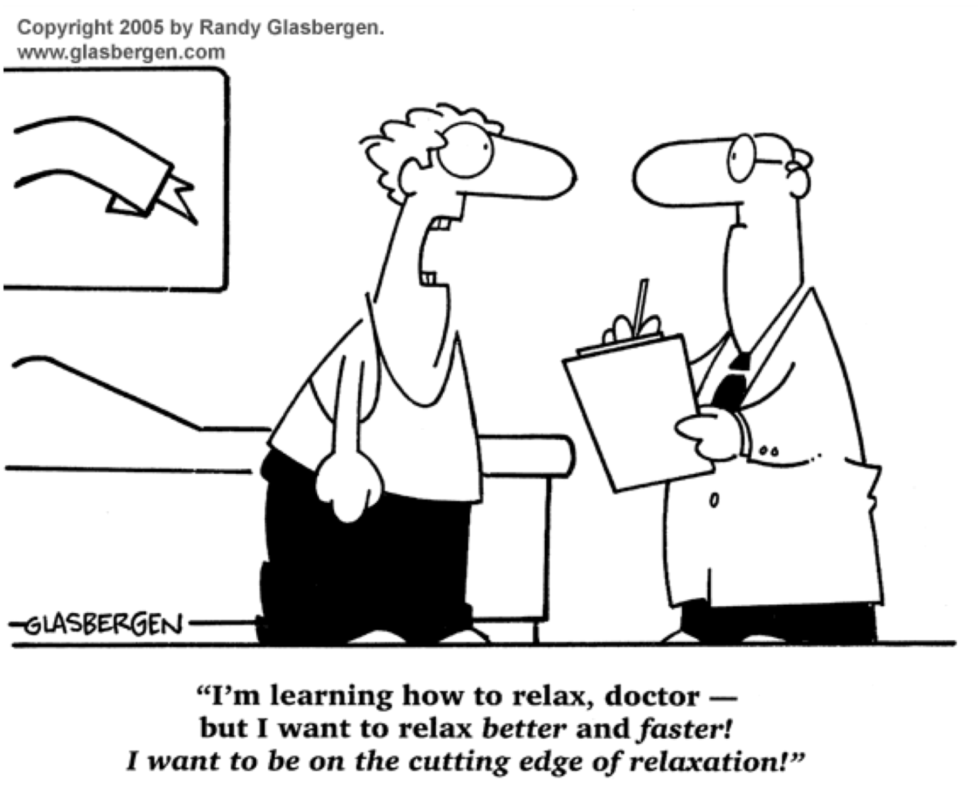

Slide 5
Key Points to Keep in Mind
Do not compare yourself to others. Compare you to yourself over time based on your realistic personal goals. We are each a work in progress.
Do not compare up. You can compare down, but any comparisons at all are optional and not always helpful.
You can always do more and do better (in theory). But thinking this way misses the intent of self-care.
Self-care is not something to be evaluated or graded.
Take pride in your efforts and the positive actions you are taking. Don’t worry about results; they will take care of themselves.

Slide 6
Additional Important Points
Strive for balance (a moving target and aspirational goal at best)
Experiment with self-care; there is no one right way and there is no list of the correct self-care activities for you. Be flexible and stay open to new ideas. Learn from experience and make changes over time as needed.
Combat negative self-talk. For example:
  I’m no good at this.
  This is impossible.
  I’ll never be able to do this.
  Everyone’s better at this than me.
  I should be better at this by now.

Slide 7
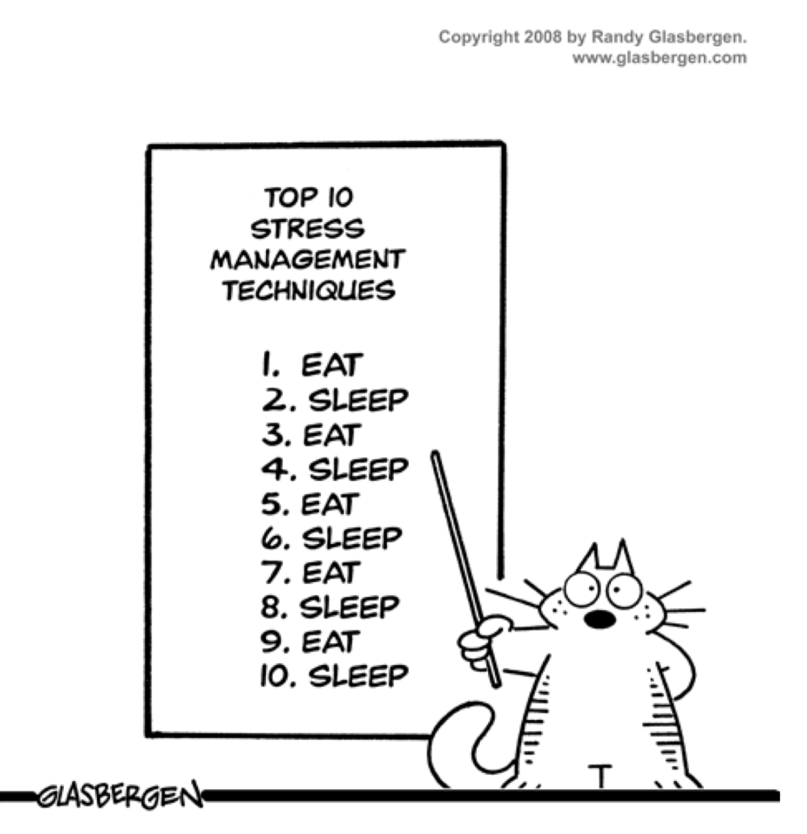

Slide 8
Self-Care and the Promotion of Wellness as a Team Effort
We are unable to accurately self-assess.
The greater our distress and burnout, the more inaccurate our self-assessments.
We must look out for each other and support each other.
It can feel risky to share openly about our struggles, but not doing so is much riskier.
We must be actively engaged in caring communities (this is entirely consistent with our Jesuit values).

Slide 9
Communitarianism and
Self-Care
Communal relationships with emotional engagement with others are essential for effective self-care.
This requires responsiveness to ‘neighbors in need’
Consider your competence constellation. Take all needed steps to develop it.

Slide 10
Potential Benefits of
Competence Constellations
Providing and receiving support; prevents/reduces stress:
  Emotional support (e.g., reassurance)
  Appraisal support (e.g., competence feedback)
  Informational support (e.g., advice)
  Instrumental support (e.g., time & resources)
They offer better judgment on functioning because
others generally better assessors

Slide 11
Moving Forward
Move forward with your personal self-care plan.
Utilize your existing support network and intentionally work to build it as may be needed.
We must look out for each other, provide support and assistance, and ask for support and assistance.
Focus on prevention. Don’t wait until you notice problems and their negative impact on your functioning.

Slide 12
More to Come
Session 4 –
Thursday, January 28, 2021. 12:00pm – 12:45pm
  Creating a culture of self-care.
  Implementing your self-care plan.

